Slide 1
Internet Voting:
Inevitable, Ineffectual or Both?
Greg Shaw
Visiting Fellow
Annenberg Public Policy Center
Notes:
Thank you for attending today. Let me begin by saying what an honor it is for me to be here this fall and to speak with you today. I’d like to extend personal thanks to Professor Russ Neuman for giving me a time and a place to pursue my interest in politics and the Internet. As many of you know, I left Microsoft this summer after 6 years as the head of Corporate Communications, where I worked on everything from product promotion to public policy and, yes, the antitrust trial. I would be happy to answer any of your questions about Microsoft or the topic at hand at the end of this presentation.
Professor Neuman asked me when I arrived in August if I would be interested in presenting a colloquium on the subject of Internet voting sometime this fall. Needless to say Internet voting was hardly generating headlines back then and I could not have predicted that it would become such a focus in the days after the election.
As you will soon learn, I am not a scholar and I am not an authority on the American electorate – as many of you are. I began my professional life as a journalist and I have throughout my career returned to writing on subjects that interest me. About 18 months ago I wrote a lengthy article on the role of the Internet in politics. To be more specific, I was interested in this question: If Kennedy was arguably the first Television President, how soon could we expect the first Internet President and what what would be the qualifications of the first Internet President? My approach then – as it is now – was to examine that question in a journalistic manner.
One issue that really lept out at me was Internet voting. If Amazon.com and buying books over the Internet was the killer app that launched e-commerce, Internet voting surely was the killer app that would launch e-politics. E-commerce is successful because you can browse the Web for information about a product or service and then buy it online. E-politics has progressed more slowly because it allows you only to browse the Web for information. You can’t consummate the deal. There is a lot of interesting progress in e-politics which Russ, Steve Schneider, Kirsten Foot and others on the E3 team are pursuing.
My purpose today is to walk you through my wanderings in this issue because of the enormous risks and benefits ascribed to Internet voting. I do not have a position on this issue other than to say I believe Internet voting is inevitable but I do not believe the risks or the benefits are as great as those claimed. (Do I sound like a politician?)
My intention is to talk for about an hour and then to open it up for what I hope will be a lively discussion.
Now, before we start, I want to ask a question. And I’d like everyone in this room to be honest. Who here did not vote in this election?

Slide 2
Editorial Drumbeat After Florida
Democracy’s Rusty Machinery
What has become embarassingly clear over the last few anxious days is that the world’s most powerful democracy needs to figure out a better way to vote for president.
Voting Made Difficult
…there were enough reports of bad judgment, poor planning and snarled paperwork to suggest the richest and most technologically advance nation on earth had still not figured out how to record quickly and accurately the preferences of its citizens.

Slide 3
Advocacy to Corporate
The biggest political football involving electronic democracy is online voting—if it becomes a reality it will signal the largest revolution so far in electronic democracy.
League of Women Voters
In the year 2004, the next presidential campaign after this one, you will find, in my opinion, the vast majority of states will already have Internet voting.
John Chambers, Cisco

Slide 4
And of course politicians
So the range of things you can do over the Internet is enormous, but you can't, as yet, vote…we want to see greater participation in our democracy. We want to see a more informed electorate. And there are certainly two basic ways in which the Internet will have a profound impact.
Gov. George Pataki
I am convinced that within five to seven years Americans will be casting their ballots on the Internet, just as easily as they can buy a stock on E-Trade today
Gov. Gray Davis
Notes:
An ABC News.COM poll, conducted last year, found that 52 percent of adults said they would oppose voting for president and other political offices over the Internet even if it were made secure from fraud.
Sixty-two percent believed it will be many years before the Internet can be made secure from fraud.
And just 20 percent in a Council for Excellence in Government poll conducted in May 1999 believed that voting by mail or the Internet would increase voter turnout.
An Andersen Consulting survey in July found 71 percent are “comfortable” with online voting.

Slide 5
“Internet voting doesn’t impress me as solving problems. To the contrary, the possibility of it being corrupted is just incredible.”
--Craig Donsanto, DOJ
Notes:
http://www.whatis.com – definition of e-voting

Slide 6
Voting Innovations & Reforms
Early voting
Vote by mail
Motor voter
Same day registration

Slide 7
If you build it will they vote?
Traugott (Michigan)
Effects on turnout were small, virtually none greater than single digit increases in turnout.
Even smaller or nonexistent effects on changing composition of electorate.
Magleby (BYU)
Introduced notion of “Novelty” in voting reforms.
High participation in vote-by-mail efforts were correlated with high media coverage.
Low participation efforts did not generate media coverage.
Brady (Standford)
Local elections have lower turnout because of low media coverage.
Solop (Northern Arizona University)
Internet voting is associated with high turnout.
Notes:
“Voting by mail became a major news story, often gaining more attention than the issue being decided.”

Slide 8
Why Internet Voting?
Low voter turnout
Credibility of government -- make the vote more representative
Inefficient elections –The Florida Effect
Greater deliberation
Cost of elections
Direct democracy
Public Demand: ecommerce? Why not epolitics?
Notes:
Rousseau said societies must push for full participation as it would increase the legitimacy of the government, but he also warned that full participation would only be effective if the people were enlightened and well informed.
Greater deliberation should include ballot review – to overcome ballot design issues
Efficient elections should include audit trail for officials
Schumpeter -- plebisicitary

Slide 9
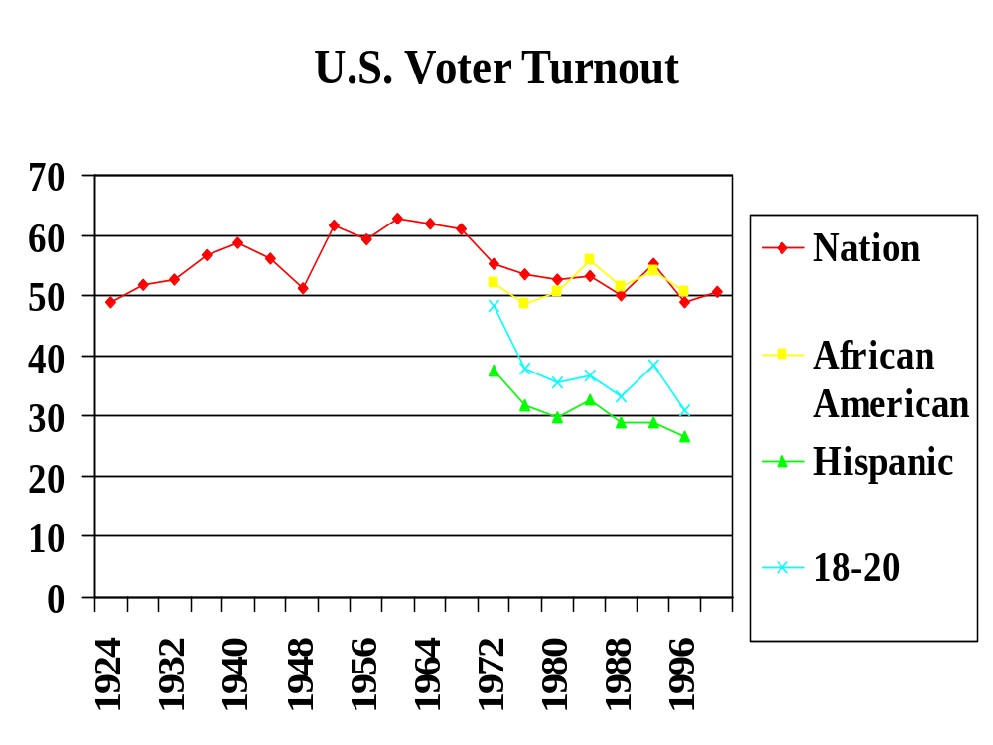

Slide 10
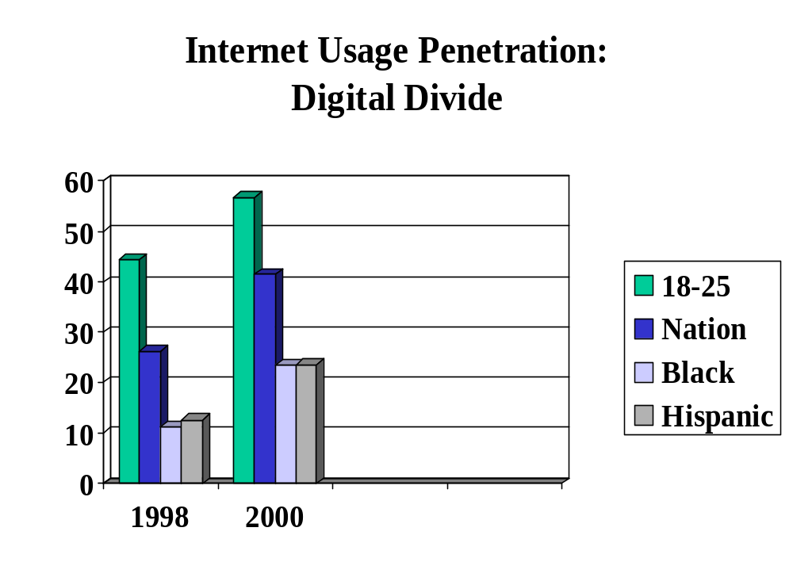

Slide 11
Who are Nonvoters?
1996 & 2000
100 million Americans
Young and poor
Doppelt/Shearer: Doers, Unpluggeds, Irritables, Don’t knows, Alienateds, Can’t votes
“We’ve got half the electorate sitting at home. The problem of non-participation continues unabated.”
Committee for the Study of the American Electorate
Notes:
Cite Dean Jamieson – How you count voters and nonvoters is quite technical. I have stuck with FEC numbers for consistency.
CONSIDER DOING A RIFF ON HOW NET VOTING WOULD HELP DOERS BUT NOT OTHERS.
Ray Wolfinger claims that stratification is not important – those who do not vote are representative of those who do.

Slide 12
What is Internet Voting?
Poll Site voting – closed network
  Security and privacy more manageable
  Supports early voting
  Avoids digital divide
  Avoids coercion and vote-selling
  Does not serve travelers, students, military
Remote voting – open network
Notes:
In this election: vote matching, vote swapping, vote trading, vote buying

Slide 13

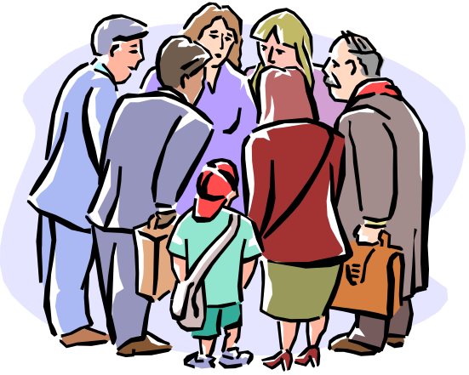
Barriers to Remote Online Voting
Privacy
Security
Access
Laws/Regs
Social/Psych
Inspection
Technology
Standards
Marketing
Digital Sign.
Notes:
Digital signature equates with voter registration and id
Social
Digital Divide
Private space v. Public space
Security
Voter authentication
Transport delivery guarantee, integrity, privacy
Double vote detection
Protection against vote-selling – vote-ster and vote-lla
Server attacks (Denial of service, viruses)
Technical
Recount
Retaining copies of votes
Software engineering – open sources, system life

Slide 14
Who’s in the game
Election Systems and Software (ESS)
  San Mateo trial
Votehere.net
  Alaska, Washington, San Diego, Maricopa, Sacramento
Election.com
  Arizona Democratic Primary
Booz Allen
  DoD pilot
Notes:
Vote Here Platinum v. 3.0!
This system is designed to meet the stringent security, audit and verification standards for public-sector elections. VoteHere Platinum, which is targeted for certification as an election system in the United States and internationally, provides the highest levels of security, privacy and verifiability.
Vote Here Gold
This system is targeted for use in private sector elections, surveys, polls, and market research. VoteHere Gold is designed for companies and organizations where security and privacy are a high priority for their online elections and the system provides greater security than typical Internet financial and e-commerce transactions. Clients include corporations, associations, unions, universities, and market research firms. No plug-in or additional software is required for VH Gold.

Slide 15
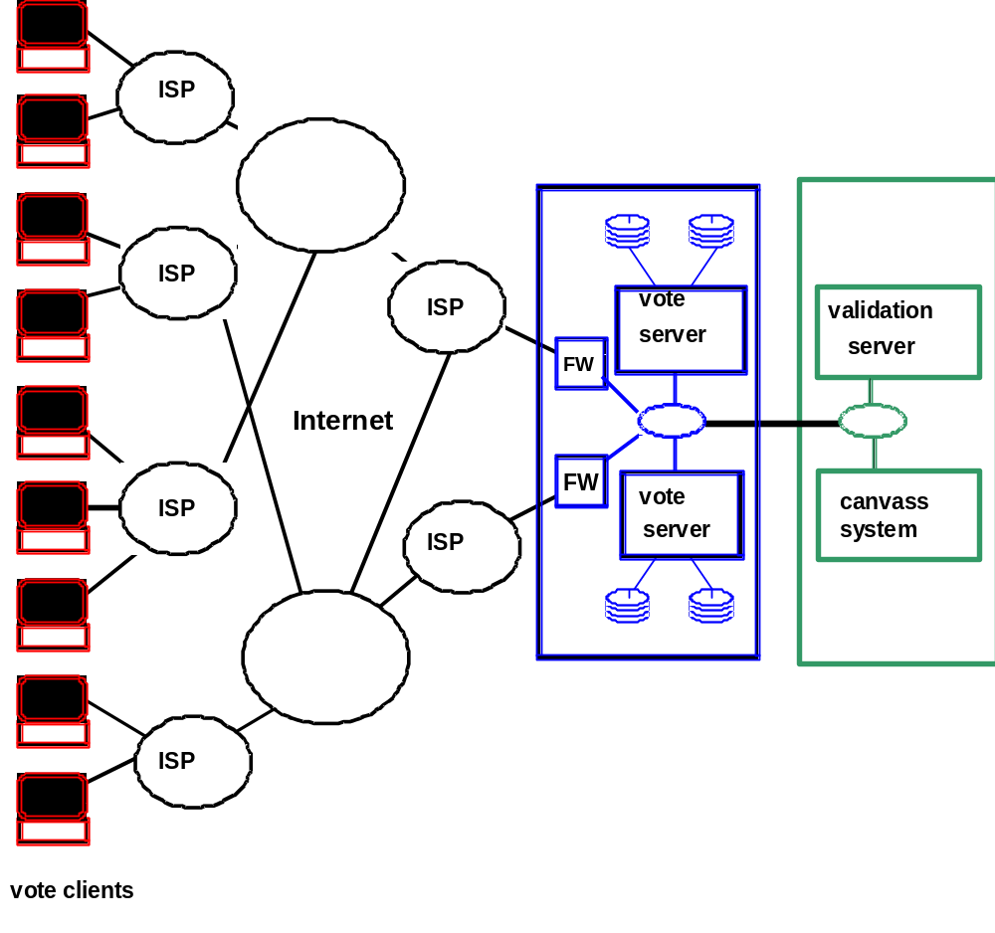
vendor-operated
secure data center
county-operated
canvas facility
Notes:
The system varies with each voting firm but the basic construction is this.

Slide 16
Department of Defense
Federal Voting Assistance Program
Notes:
Two years ago federal state and county election officials met to talk about how to improve voting for military based overseas
They had to work through all of the problems associated with Internet voting.

Slide 17
DOD Voting Over Internet
Participants: Orange and Okaloosa (Florida), Weber (Utah), Dallas (Texas), South Carolina
Goal: 350 U.S. Military personnel and family members based overseas
Test Public Key Infrastructure (PKI) encryption software (Booz Allen)
Remote voting
Communications
  Base newspapers
  Company/Division meetings
  DOD public affairs
What were the results?

Slide 18
DOD Voting Over Internet
Less than 100 participants
Hardly representative
No ADA or access issues
Extremely limiting local regulations
PKI was cumbersome – loading and reloading software
The Colonel factor
Narrow communications/marketing vehicles
Notes:
Colonel – coercion? Did not want software on their systems

Slide 19
Arizona Democratic Primary
By cajoling the young, elderly, and everyone in between to vote via the Web, Arizona's Democrats are hoping to rejuvenate their party and reverse the dismal turnout that has characterized past elections.
--Wired

Slide 20
Arizona Democratic Primary
Democratic Party contracted with Election.com
Challenged by Voting Integrity Project on Digital Divide grounds
Appeals will be heard Jan. 2001
Offered pollsite and remote
Dr. Fred Solop of Northern Arizona University studied the project
What were the results?
Notes:
A competitor estimates that the Election.com contract was $1 million with 2/3^{rds} going to marketing the capability

Slide 21
Arizona Democratic Primary
Low turnout overall but 48 percent of ballots cast over the Internet. 90% voted remotely.
High income & young most likely to cast eballots
No state certification
Vulnerable to attacks/hacks
Weak voter authentication
Poor voter privacy
Business activity and publicity effort
Allegations that it did not support Linux, mac and older Netscape versions
Shining ex. of Internet voting future or Novelty?
Notes:
On poor privacy – Compaq alleges that election.com issued PINs and could have matched votes and voters – re: Orange County lapse

Slide 22
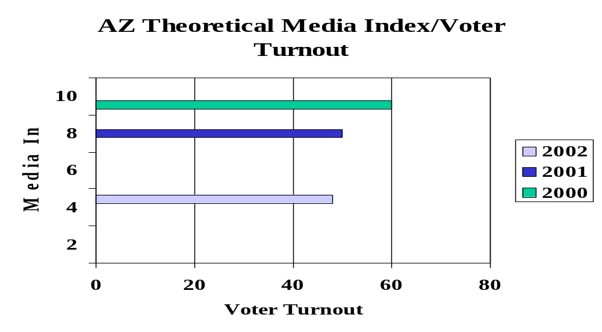
Testing the Novelty Theory
Media Index v. Voter Turnout
  $s spent on marketing
  # of stories in local media mentioning the online capability
  # of impressions of those stories
  Example:
    0-500,000 = 1
    500,001-750,000 = 2

Slide 23
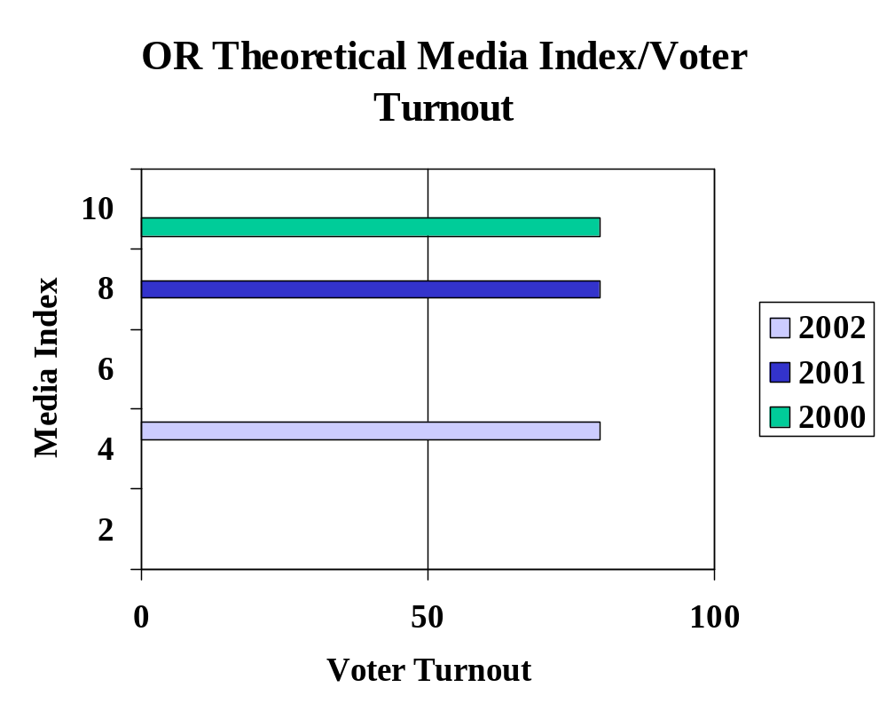

Slide 24
Timeline for Online Voting
Spring
NSF, IPI report and recommendations
White House report
California will certify its first Internet voting system
Arizona Democratic Primary case heard
Annenberg Internet and politics conference
Fall
Expect first Internet public election

Slide 25
Questions Raised
What is the impact of entering a private space to vote for public purposes?
How do we protect the public’s role – poll volunteers, inspection?
If voter turnout is an important goal, why not make elections compulsory or offer economic incentives?
Is Internet voting only one part of Internet reforms in politics?
At what point do the benefits of Internet voting outweigh the risks?
If we encourage young voters now with Internet voting will they remain voters?

Slide 26
“…the use of new communications technology for old or new purposes…[and] all other possibilities for the exchange of social meaning, are always introduced into a pattern of tension created by the coexistence of old and new…”
--Professor Carolyn Marvin
When Old Technologies Were New

